Slide 1

MALIGNANT COMMENTS CLASSIFIER PROJECT
Submitted By:
Lakshmi Rajendra Thute

Slide 2

INTRODUCTION
The proliferation of social media enables people to express their opinions widely online. However, at the same time, this has resulted in the emergence of conflict and hate, making online environments uninviting for users. Although researchers have found that hate is a problem across multiple platforms, there is a lack of models for online hate detection.
Online hate, described as abusive language, aggression, cyberbullying, hatefulness and many others has been identified as a major threat on online social media platforms. Social media platforms are the most prominent grounds for such toxic behaviour.
Internet comments are bastions of hatred and vitriol. While online anonymity has provided a new outlet for aggression and hate speech, machine learning can be used to fight it. The problem we sought to solve was the tagging of internet comments that are aggressive towards other users. This means that insults to third parties such as celebrities will be tagged as unoffensive, but “u are an idiot” is clearly offensive.
Our goal is to build a prototype of online hate and abuse comment classifier which can used to classify hate and offensive comments so that it can be controlled and restricted from spreading hatred and cyberbullying

Slide 3
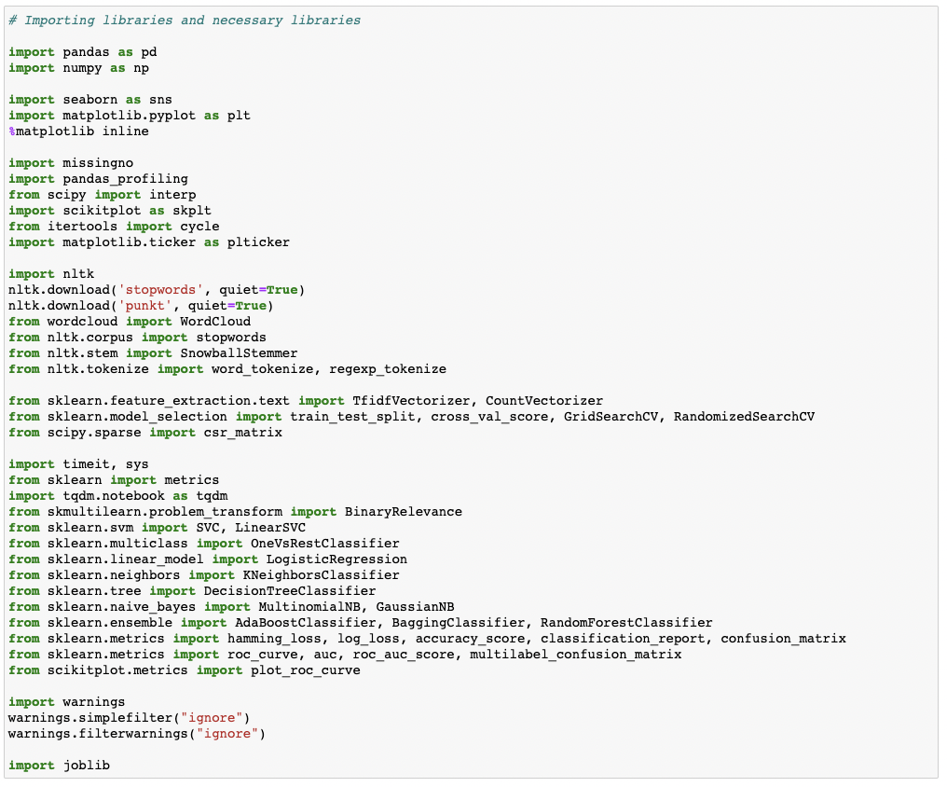
ANALYTICAL PROBLEM FRAMING
We were given two datasets to work with in this project: train and test CSV files. Using NLP and the train dataset, I will create a machine learning model. We'll generate predictions for our test dataset using this model.
Multiple classification machine learning models will be required.
All data pre-processing processes using NLP must be completed before model development. After experimenting with several classification models and hyper parameters, the optimal model will be chosen.

Slide 4
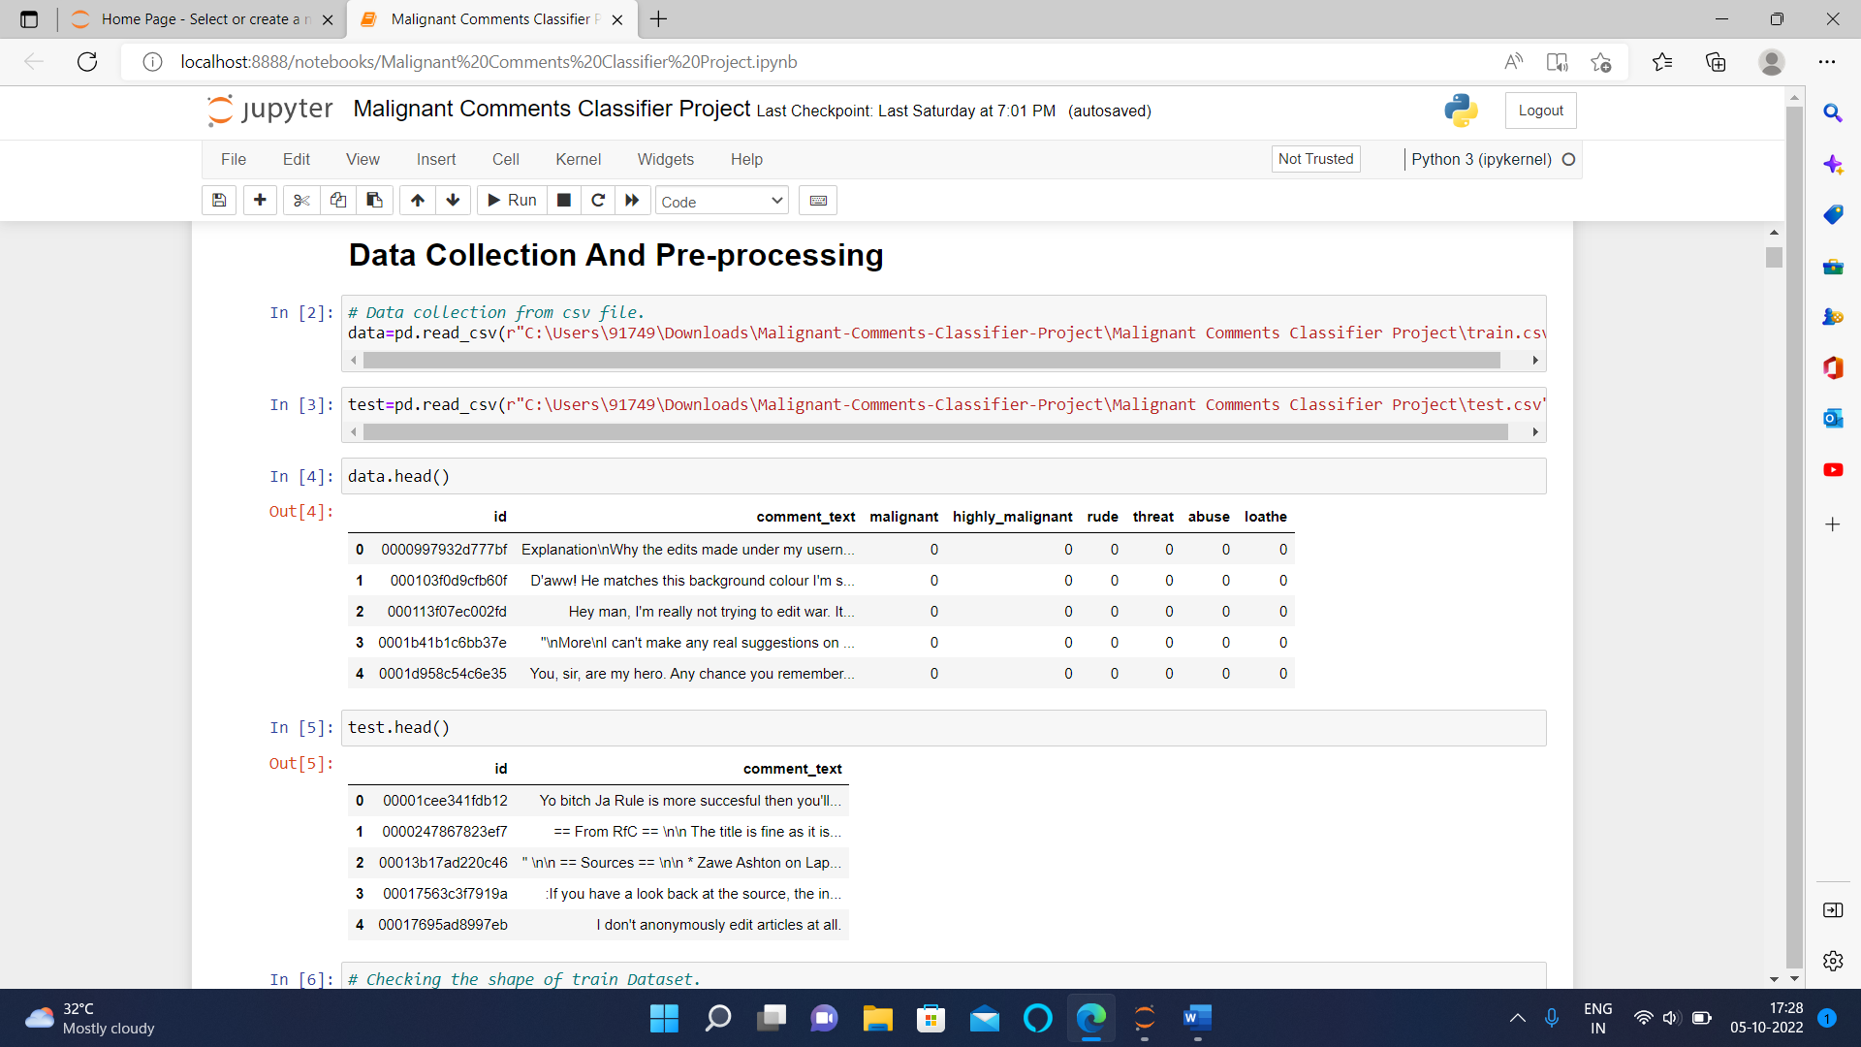
DATA COLLECTION AND PRE-PROCESSING
Before developing the classification model prediction, the following pre-processing pipeline must be completed:
1. Load the dataset
2. Remove any values that are null.
3. Remove the column id.
4. Lowercase the comment text and replace the 'n' with a single space.
5. Remove all other data from the comment text except text data (a-z).
6. Eliminate all stop words and punctuation marks.
7. Use the Snowball Stemmer to apply stemming.
8. Use TfidfVectorizer to convert text to vectors.
9. Load a model that has been stored or serialised.
10. Predict multi-class label values.

Slide 5
EXPLORATORY DATA ANALYSIS

Slide 6
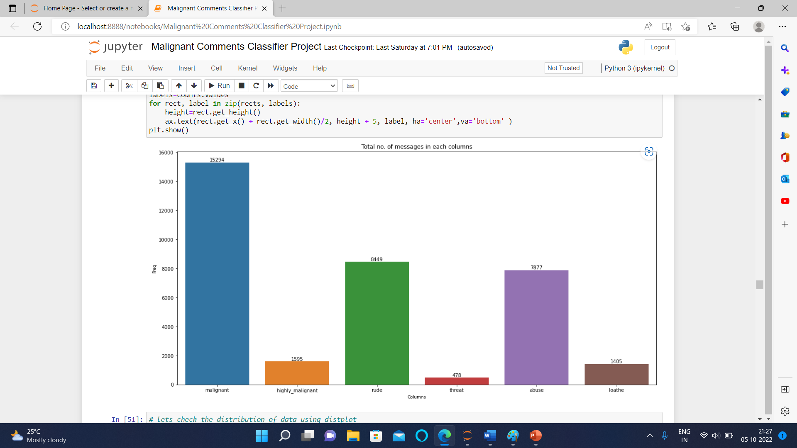

Slide 7
OBSERVATIONS
Here in the first graph of malignant we can clearly observe that most of the messages are not malignant.
In the second image we can clearly observe that there are very less highly malignant messages.
Same in third picture there are few rude comments in the dataset.
In 4th we can clearly see that there are very few cases/almost negligible of threat comments
In 5th image we can clearly see that there are some messages with abusive language.
While in the sixth image we can clearly see that there are very few cases of loathe messages.
In 7th image we can see the no. of words in each row.
In 8th image we can see the cleaned no. of remaining words in each row

Slide 8
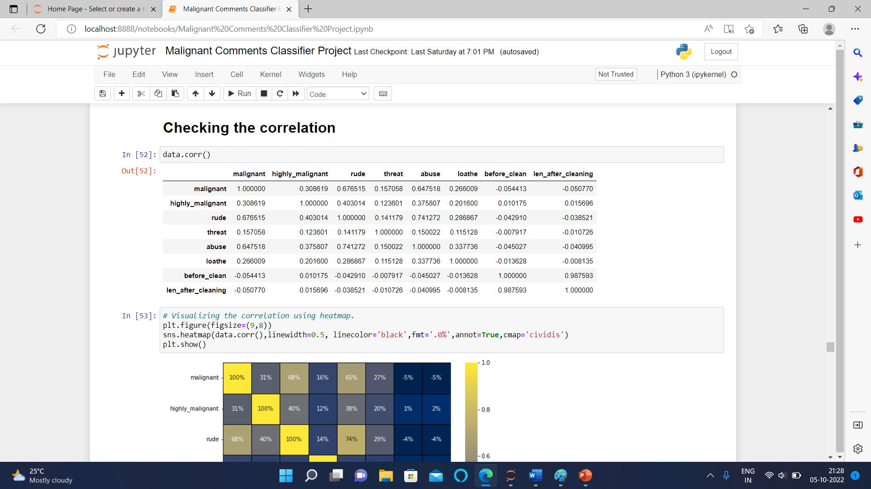
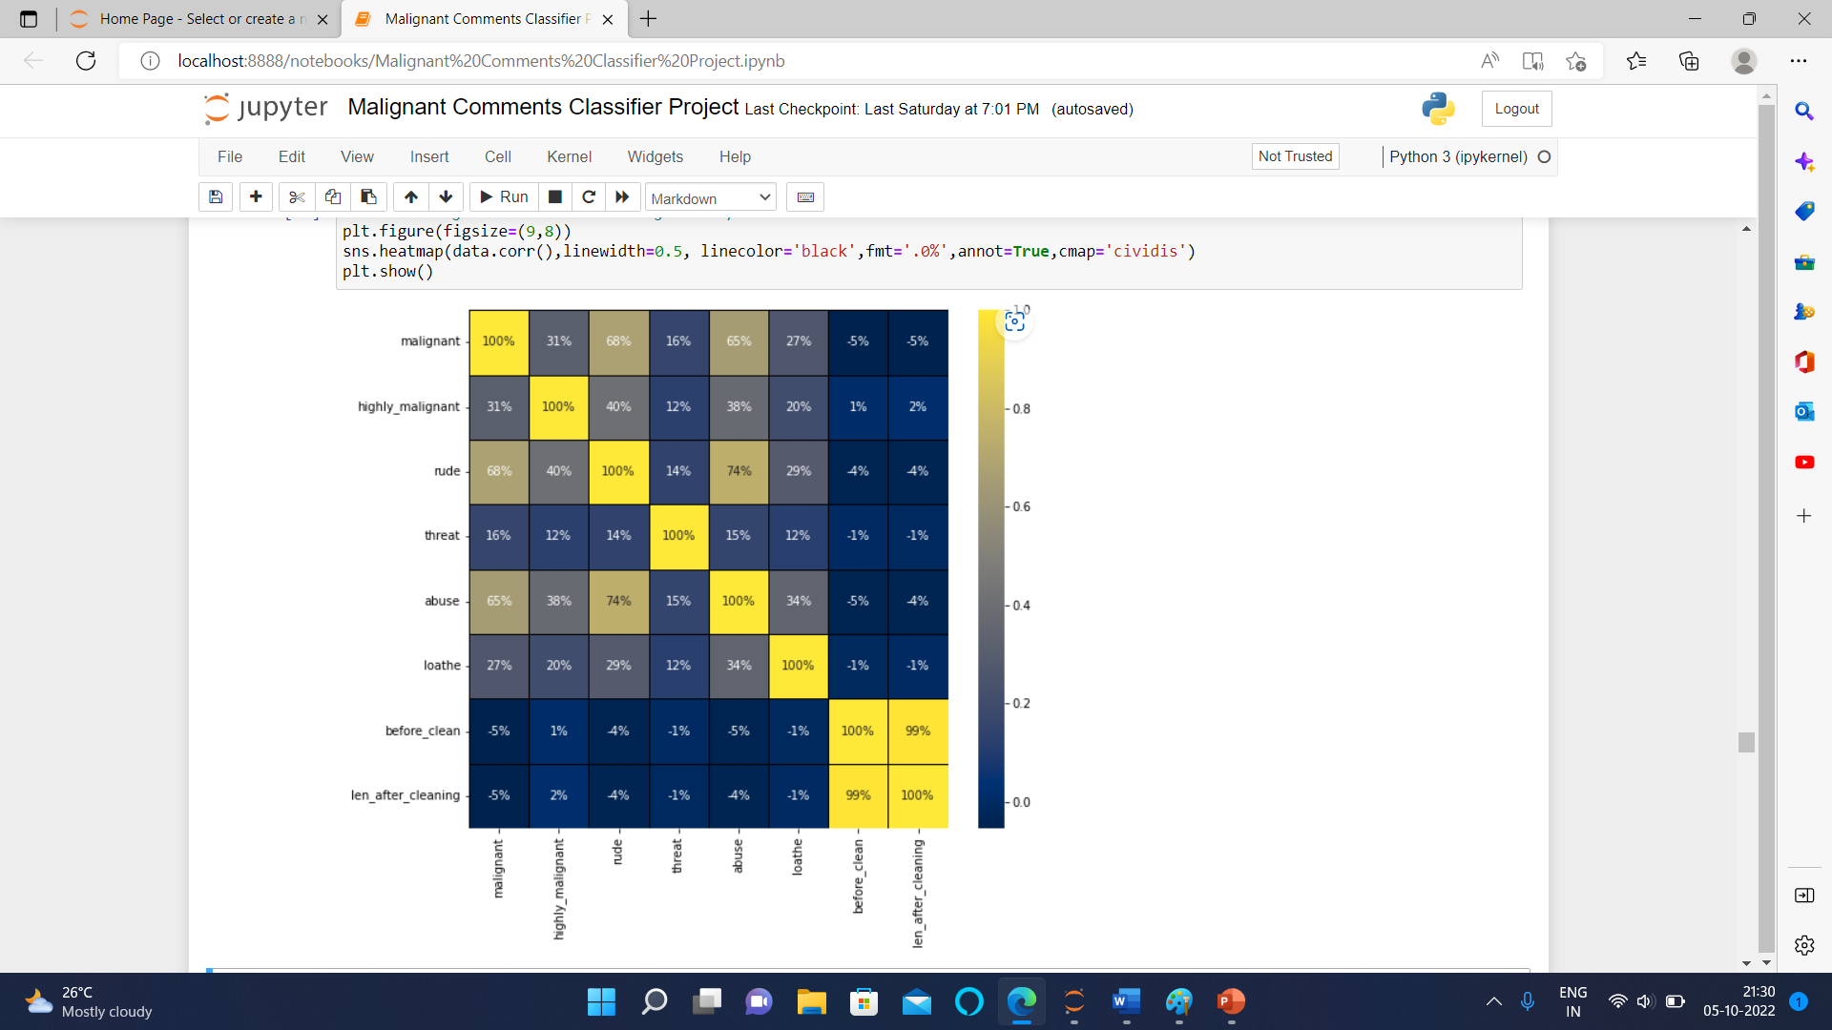
CORRELATION CHECKED
Here we can see that only 2 values are present in all the columns i.e. 0 and 1. Low score of standard deviations tells us that the data is not spreaded. there is difference in mean and median which tells us that some skewness is present. very low difference in 75% and max shows that there are no outliers present in the dataset.

Slide 9
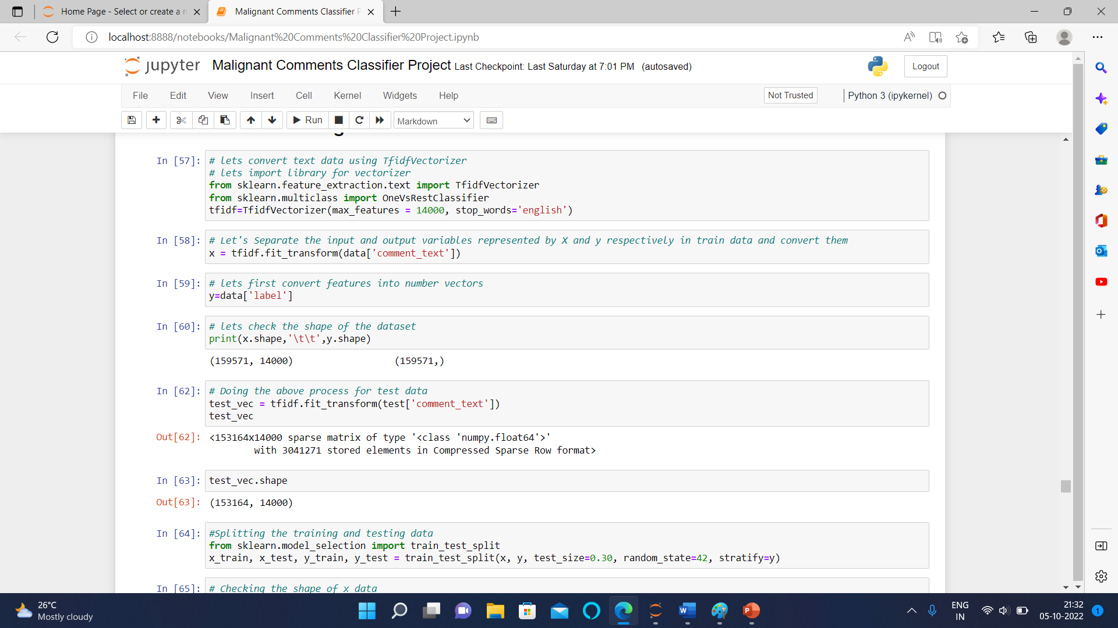
MODEL BUILDING AND EVALUATION

Slide 10
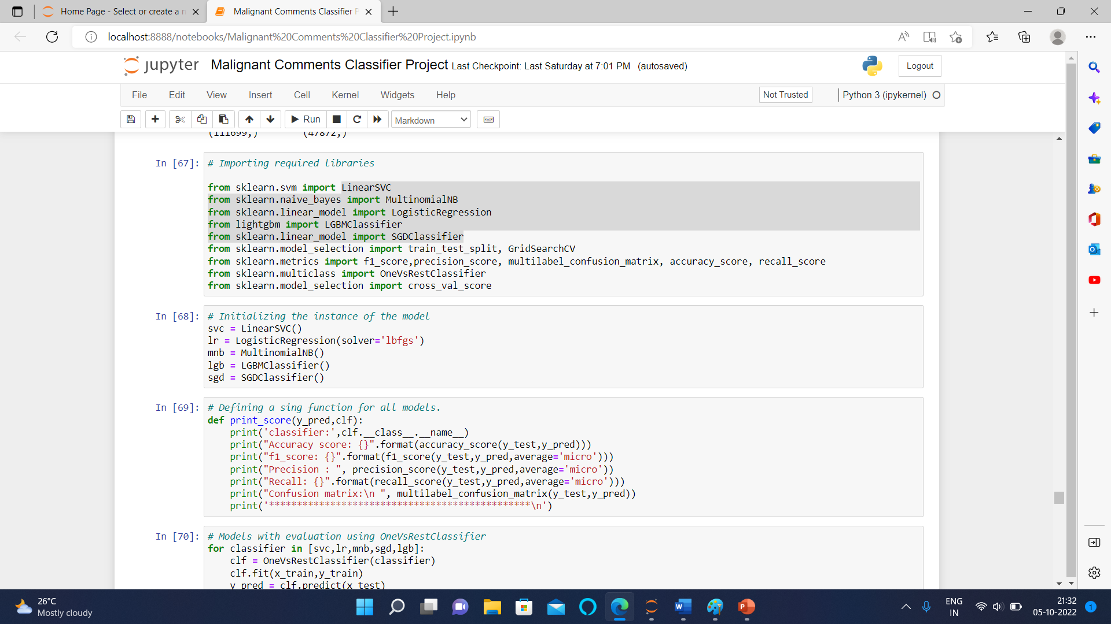

Slide 11
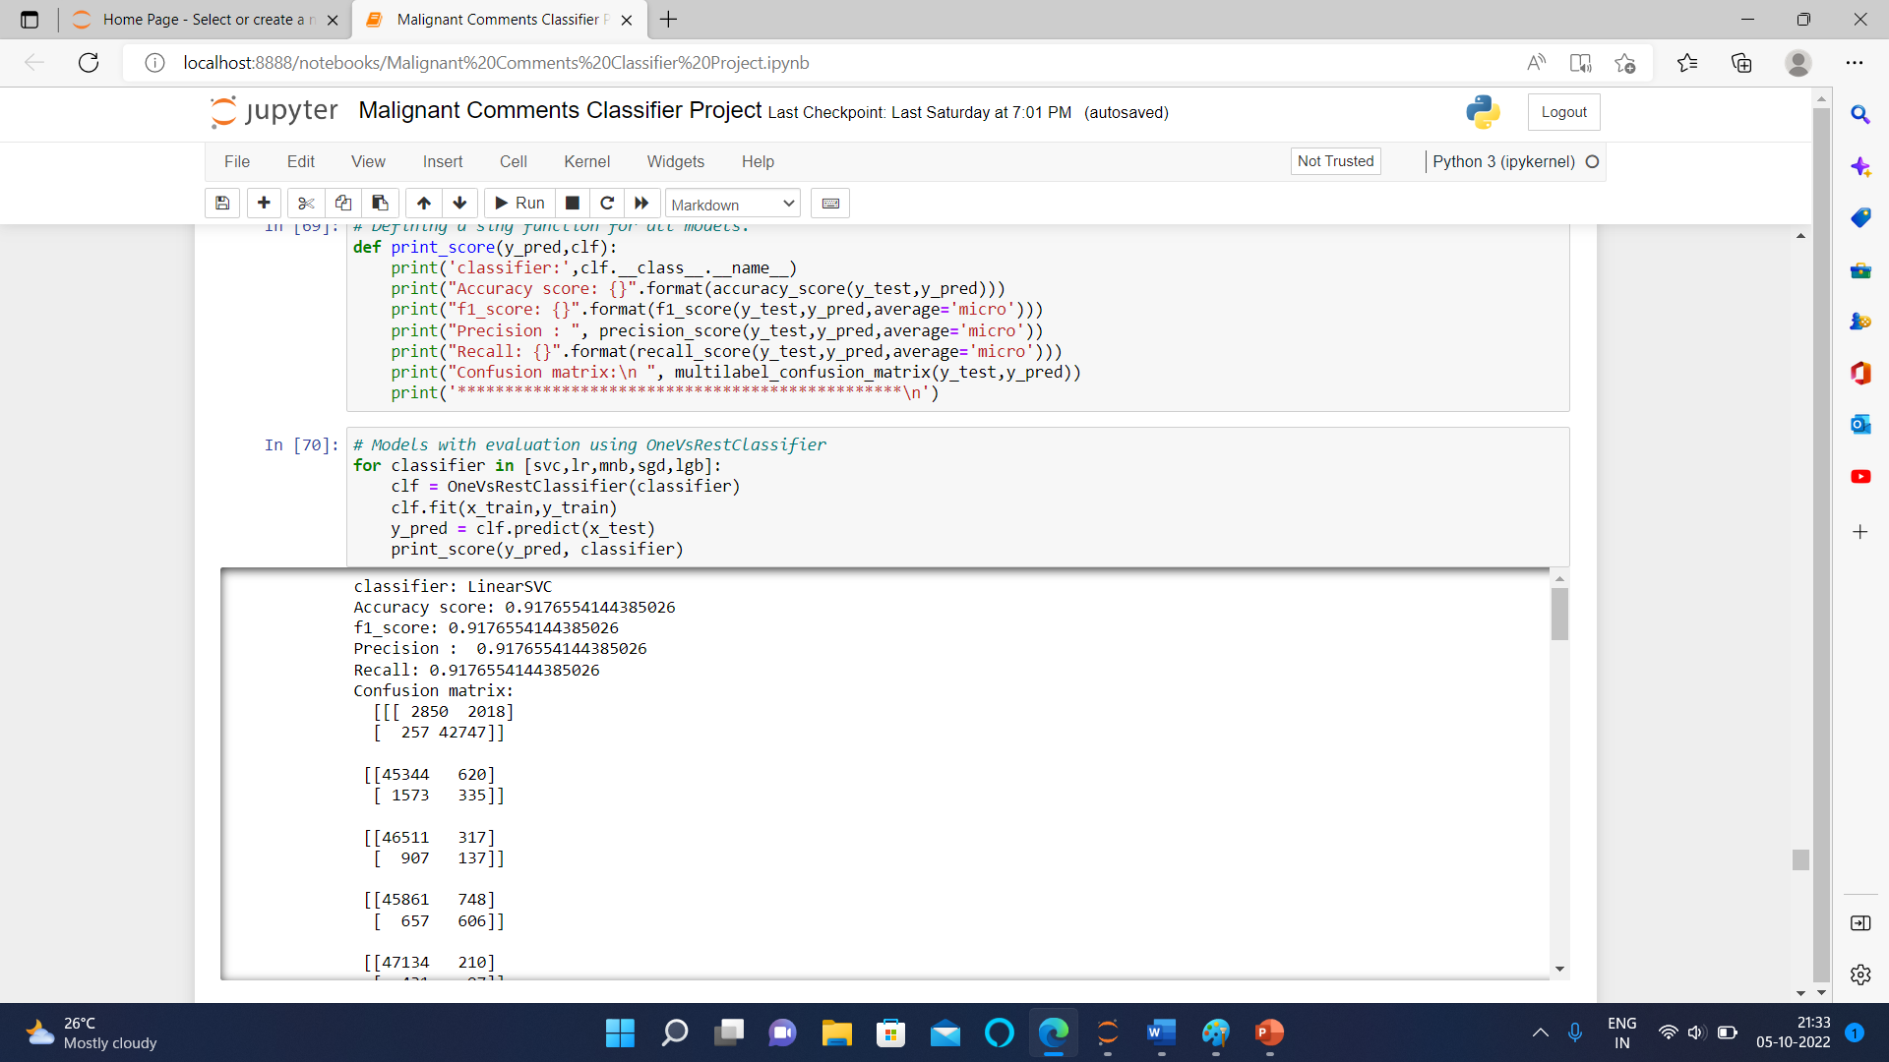

Slide 12
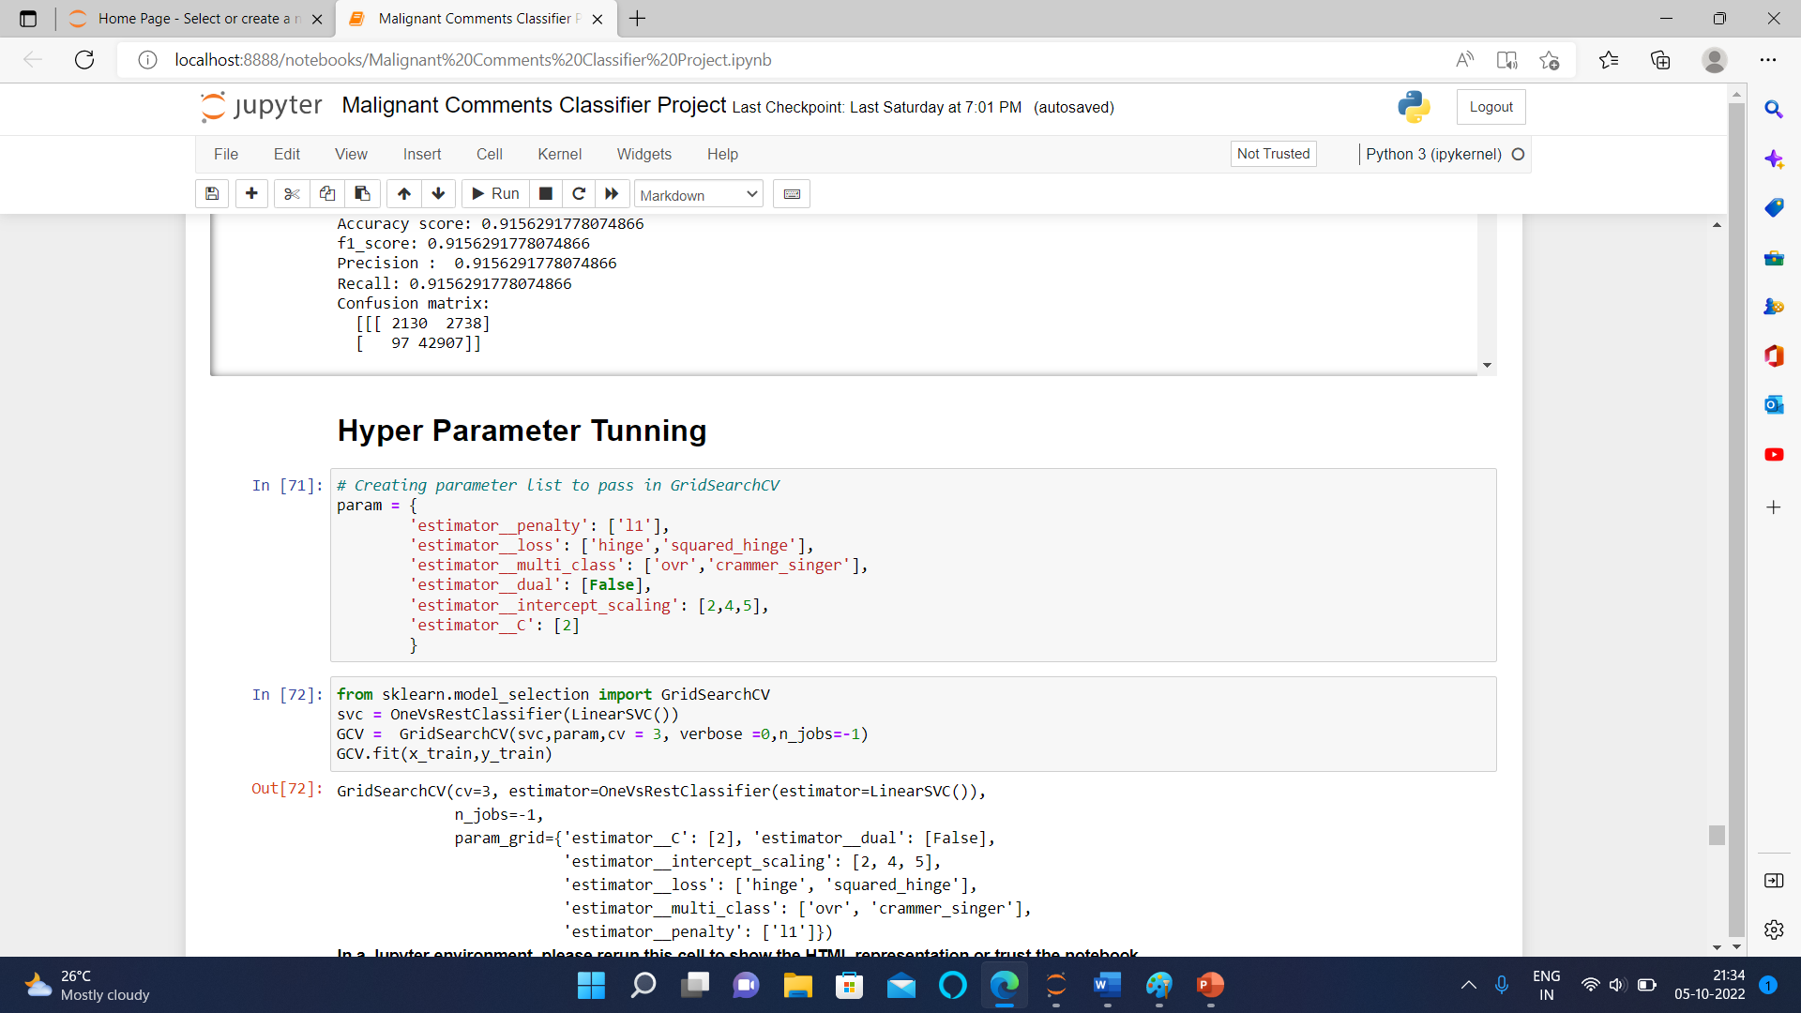
HYPER PARAMETER TUNNING

Slide 13
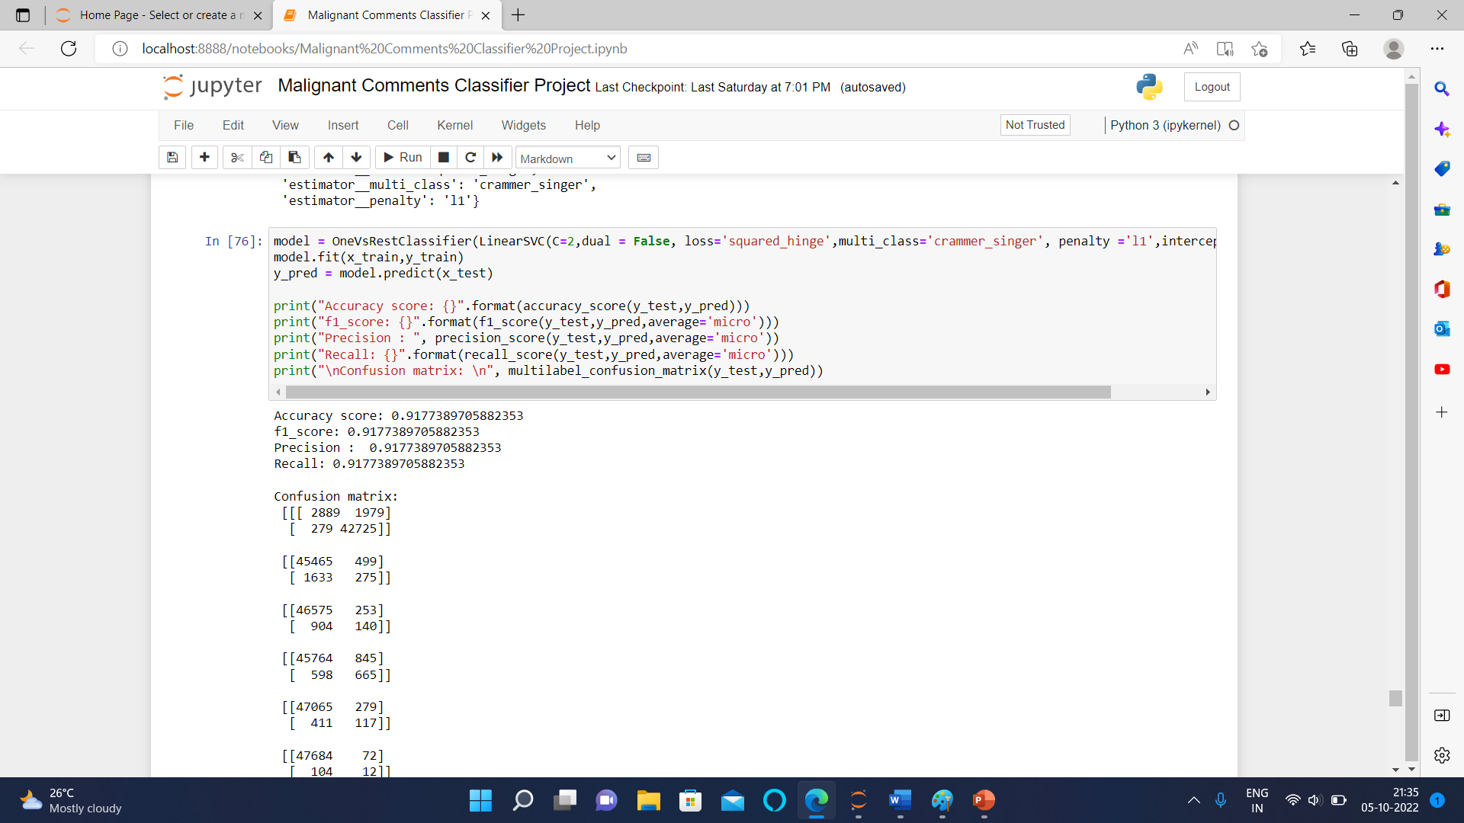

Slide 14
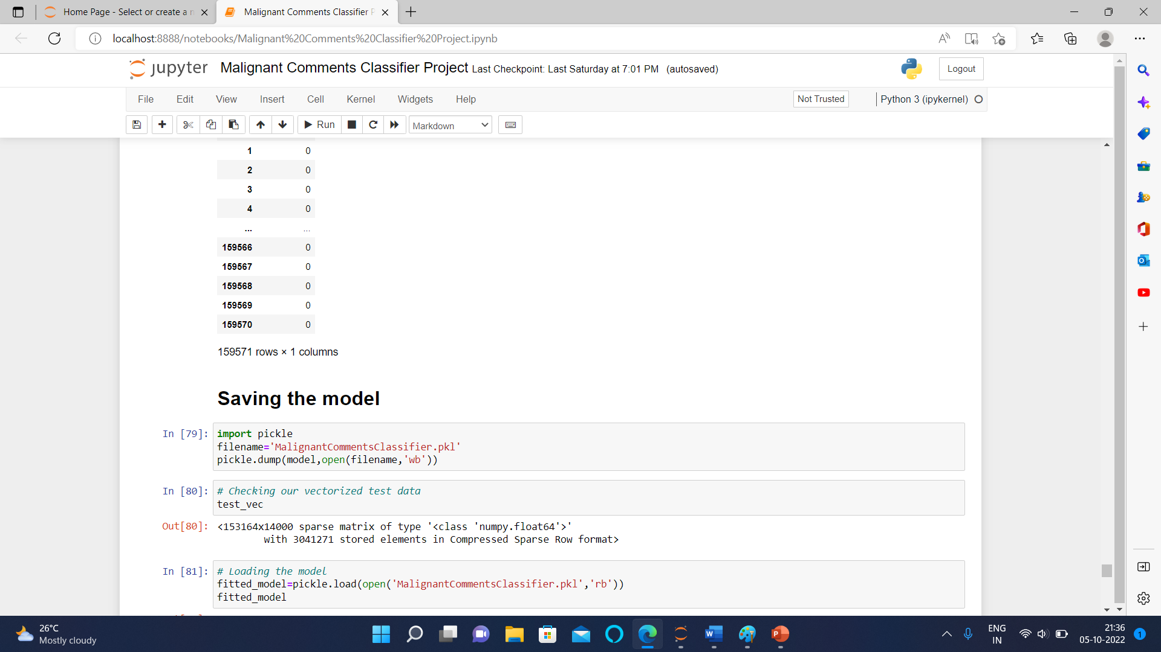
SAVING THE BEST MODEL

Slide 15
INTERPRETATION OF RESULTS
Starting with univariate analysis, it was discovered that the dataset is unbalanced, with more records for normal comments than for negative remarks (including malignant, very malignant, impolite, threat, abuse, and detest). Furthermore, using a distribution plot for comment length, it was discovered that after cleaning, the majority of comment length reduces from 0-1100 to 0-900. Moving on to the word cloud, it was discovered that malignant comments contain terms such as fuck, nigger, moron, hatred, suck, and so on. Words like ass, fuck, bitch, shit, die, suck, faggot, and others appear often in highly malignant remarks. Words like nigger, ass, fuck, suck, crap, bitch, and others are used in nasty statements. Words like death, must die, kill, murder, and others are used in threat statements. Words like stupid, nigger, obese, jew, bitch, and others are used in abusive comments. and despise remarks include phrases such as nigga, dumb, nigger, die, gay, cunt, and so on.

Slide 16
THANK YOU

